Slide 1
Unit 6
Introduction to OOAD : Unified Process – UML diagram
Use case diagram
Class diagrams
Interaction diagrams
State diagrams
Activity diagrams – package ,component and deployment diagrams.
Design: Unified Modelling language for use case diagrams and Class Diagrams

Slide 2
Introduction to UML
Unified Modeling Language (UML) is a general-purpose modeling language. The main aim of UML is to define a standard way to visualize the way a system has been designed. It is quite similar to blueprints used in other fields of engineering. UML is not a programming language, it is rather a visual language.
Why do we need UML?
We need UML (Unified Modeling Language) to visually represent and communicate complex system designs, facilitating better understanding and collaboration among stakeholders. Below is why we need UML:
Complex applications need collaboration and planning from multiple teams and hence require a clear and concise way to communicate amongst them.
Businessmen do not understand code. So UML becomes essential to communicate with non-programmers about essential requirements, functionalities, and processes of the system.
A lot of time is saved down the line when teams can visualize processes, user interactions, and the static structure of the system.

Slide 3
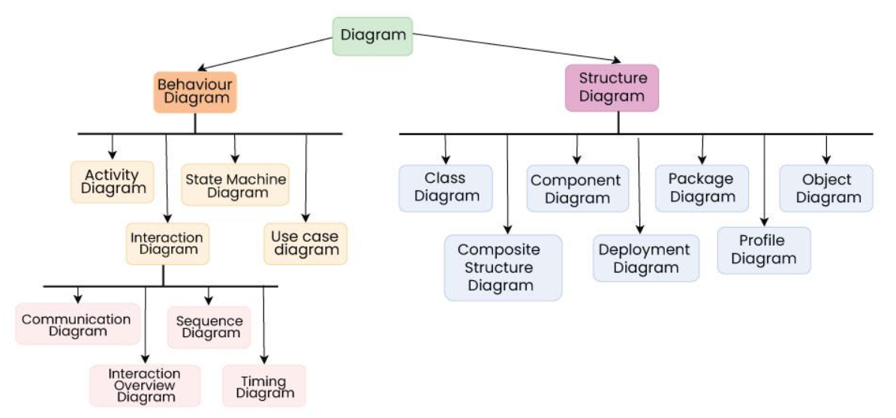
Types of UML Diagrams
UML is linked with object-oriented design and analysis. UML makes use of elements and forms associations between them to form diagrams. Diagrams in UML can be broadly classified as:

Slide 4
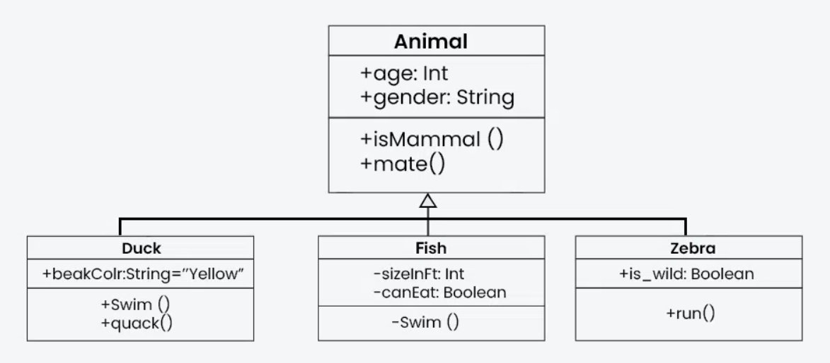
Class Diagram
The most widely use UML diagram is the class diagram. It is the building block of all object oriented software systems. We use class diagrams to depict the static structure of a system by showing system’s classes, their methods and attributes. Class diagrams also help us identify relationship between different classes or objects.

Slide 5
Composite Structure Diagram
We use composite structure diagrams to represent the internal structure of a class and its interaction points with other parts of the system.
A composite structure diagram represents relationship between parts and their configuration which determine how the classifier (class, a component, or a deployment node) behaves.
They represent internal structure of a structured classifier making the use of parts, ports, and connectors.
We can also model collaborations using composite structure diagrams.
They are similar to class diagrams except they represent individual parts in detail as compared to the entire class.

Slide 6
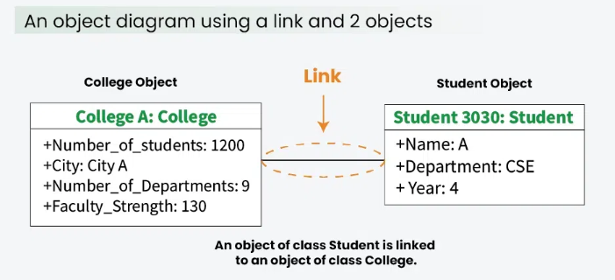
Object Diagram
An Object Diagram can be referred to as a screenshot of the instances in a system and the relationship that exists between them. Since object diagrams depict behaviour when objects have been instantiated, we are able to study the behaviour of the system at a particular instant.
An object diagram is similar to a class diagram except it shows the instances of classes in the system.
We depict actual classifiers and their relationships making the use of class diagrams.
On the other hand, an Object Diagram represents specific instances of classes and relationships between them at a point of time.

Slide 7
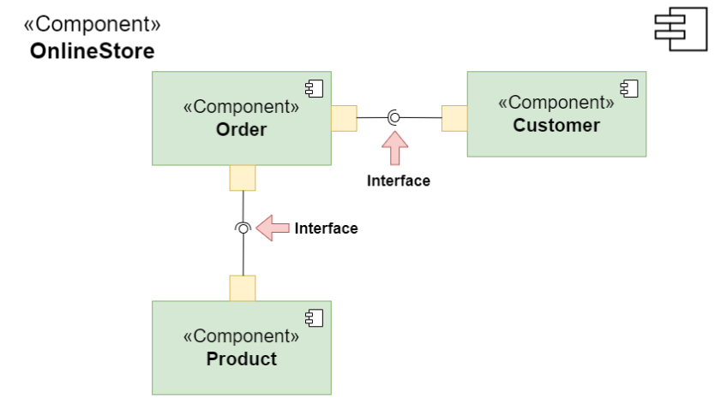
Component diagrams
Component diagrams are used to represent how the physical components in a system have been organized. We use them for modelling implementation details.
Component Diagrams depict the structural relationship between software system elements and help us in understanding if functional requirements have been covered by planned development.
Component Diagrams become essential to use when we design and build complex systems.
Interfaces are used by components of the system to communicate with each other.

Slide 8
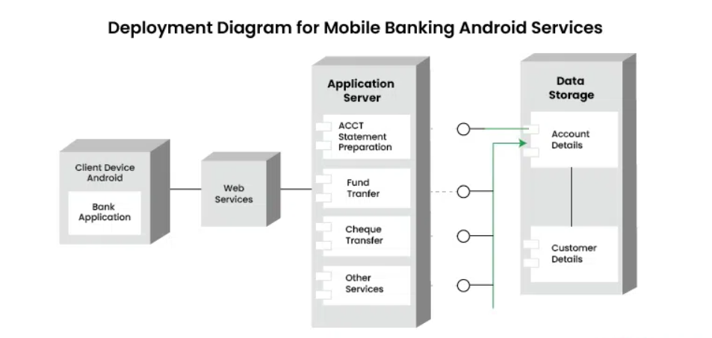
Deployment Diagrams
Deployment Diagrams are used to represent system hardware and its software. It tells us what hardware components exist and what software components run on them.
We illustrate system architecture as distribution of software artifacts over distributed targets.
An artifact is the information that is generated by system software.
They are primarily used when a software is being used, distributed or deployed over multiple machines with different configurations.

Slide 9
Package Diagrams
We use Package Diagrams to depict how packages and their elements have been organized. A package diagram simply shows us the dependencies between different packages and internal composition of packages.
Packages help us to organise UML diagrams into meaningful groups and make the diagram easy to understand.
They are primarily used to organise class and use case diagrams.

Slide 10
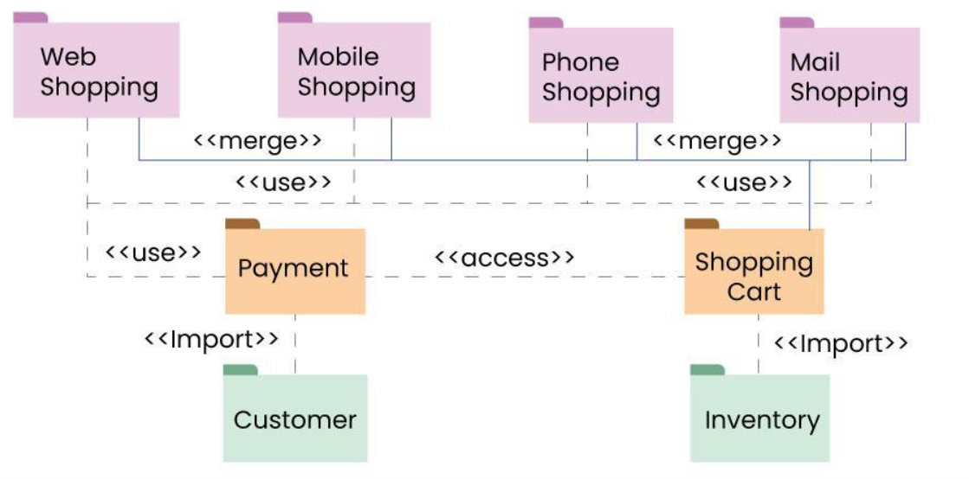

Slide 11
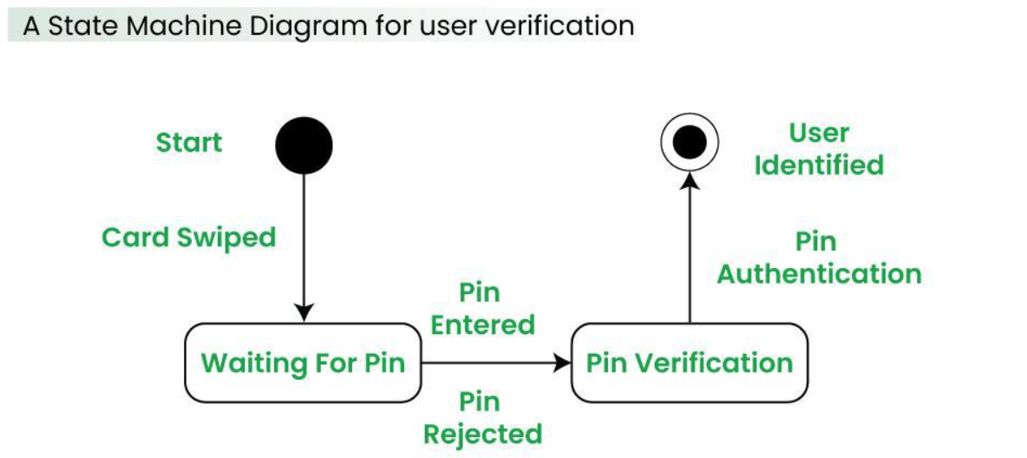
State diagram
A state diagram is used to represent the condition of the system or part of the system at finite instances of time. It’s a behavioral diagram and it represents the behavior using finite state transitions.
State diagrams are also referred to as State machines and State-chart Diagrams
These terms are often used interchangeably. So simply, a state diagram is used to model the dynamic behavior of a class in response to time and changing external stimuli.

Slide 12
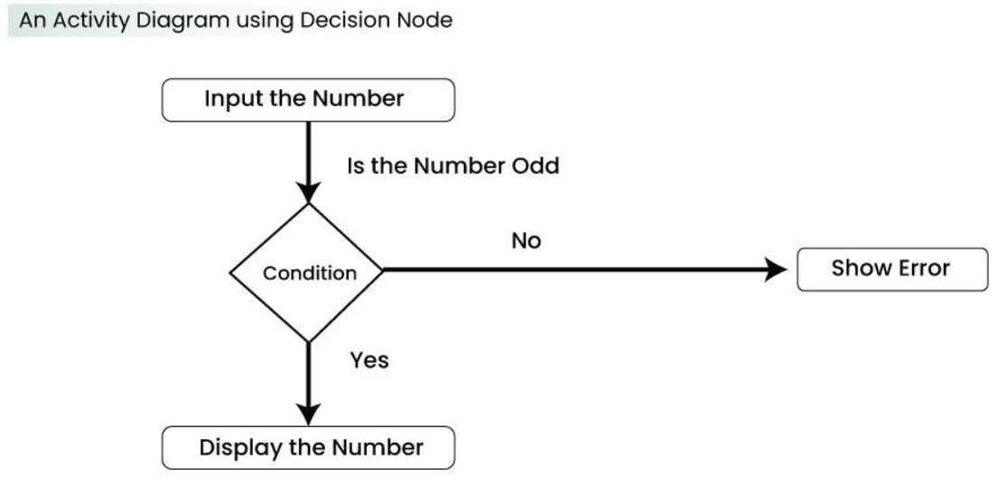
Activity Diagrams
We use Activity Diagrams to illustrate the flow of control in a system. We can also use an activity diagram to refer to the steps involved in the execution of a use case.
We model sequential and concurrent activities using activity diagrams. So, we basically depict workflows visually using an activity diagram.
An activity diagram focuses on condition of flow and the sequence in which it happens.
We describe or depict what causes a particular event using an activity diagram.

Slide 13
Use Case Diagrams
Use Case Diagrams are used to depict the functionality of a system or a part of a system. They are widely used to illustrate the functional requirements of the system and its interaction with external agents(actors).
A use case is basically a diagram representing different scenarios where the system can be used.
A use case diagram gives us a high level view of what the system or a part of the system does without going into implementation details. ‘

Slide 14
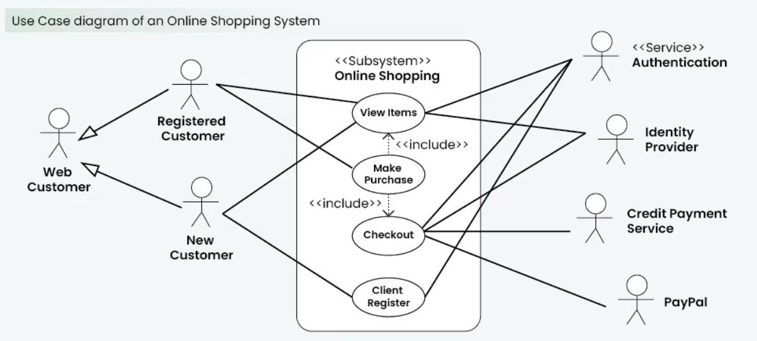

Slide 15
Sequence diagram
A sequence diagram simply depicts interaction between objects in a sequential order i.e. the order in which these interactions take place.
We can also use the terms event diagrams or event scenarios to refer to a sequence diagram.
Sequence diagrams describe how and in what order the objects in a system function.
These diagrams are widely used by businessmen and software developers to document and understand requirements for new and existing systems.

Slide 16
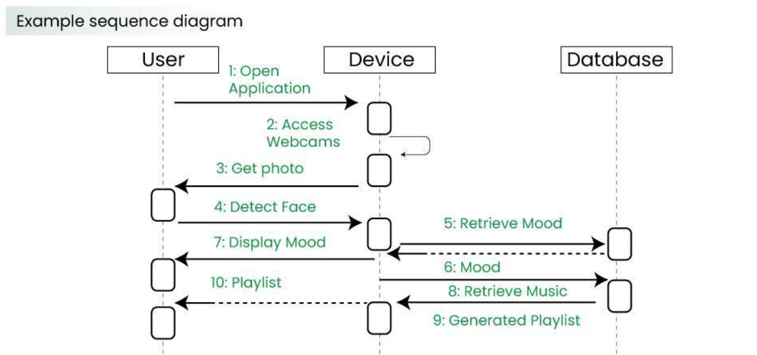

Slide 17
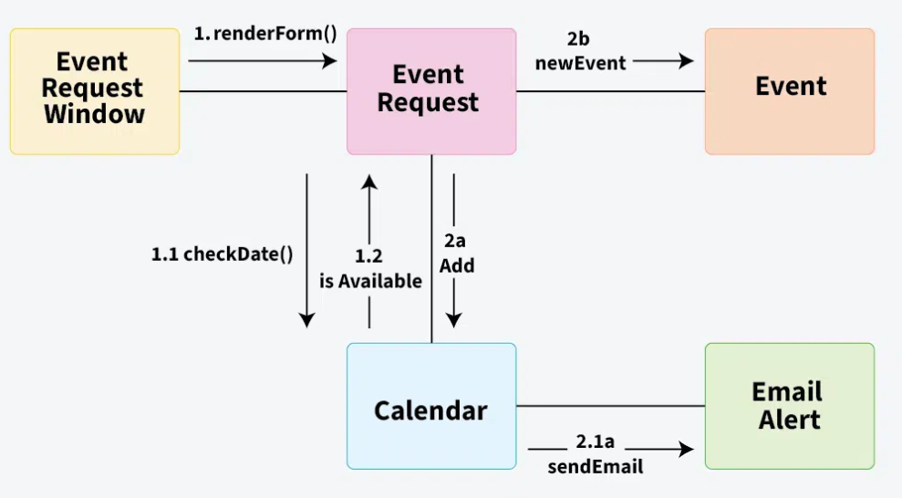
Communication Diagram
A Communication Diagram (known as Collaboration Diagram in UML 1.x) is used to show sequenced messages exchanged between objects.
A communication diagram focuses primarily on objects and their relationships.
We can represent similar information using Sequence diagrams, however communication diagrams represent objects and links in a free form.

Slide 18
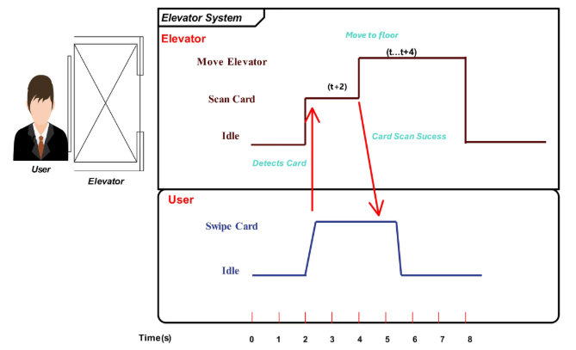
Timing Diagram
Timing Diagram are a special form of Sequence diagrams which are used to depict the behavior of objects over a time frame. We use them to show time and duration constraints which govern changes in states and behavior of objects.

Slide 19
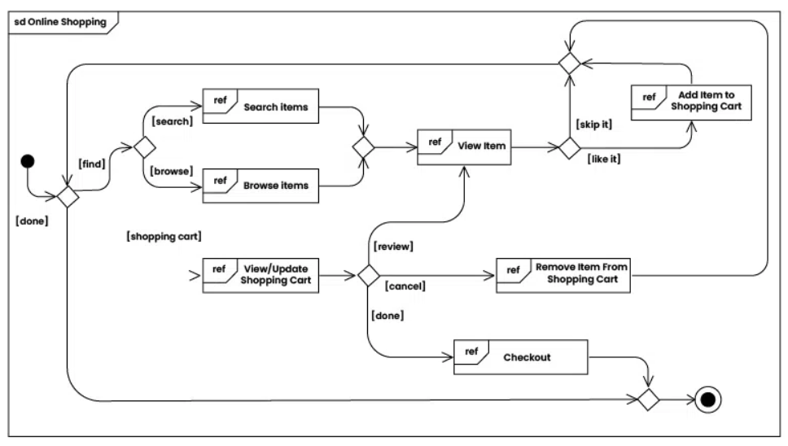
Interaction Overview Diagram
An Interaction Overview Diagram (IOD) is a type of UML (Unified Modeling Language) diagram that illustrates the flow of interactions between various elements in a system or process. It provides a high-level overview of how interactions occur, including the sequence of actions, decisions, and interactions between different components or objects.

Slide 20
Tools for creating UML Diagrams
There are several tools available for creating Unified Modeling Language (UML) diagrams, which are commonly used in software development to visually represent system architecture, design, and implementation. Here are some popular UML diagram creating tools:
Lucidchart: Lucidchart is a web-based diagramming tool that supports UML diagrams. It’s user-friendly and collaborative, allowing multiple users to work on diagrams in real-time.
Draw.io: Draw.io is a free, web-based diagramming tool that supports various diagram types, including UML. It integrates with various cloud storage services and can be used offline.
Visual Paradigm: Visual Paradigm provides a comprehensive suite of tools for software development, including UML diagramming. It offers both online and desktop versions and supports a wide range of UML diagrams.
StarUML: StarUML is an open-source UML modeling tool with a user-friendly interface. It supports the standard UML 2.x diagrams and allows users to customize and extend its functionality through plugins.

Slide 21
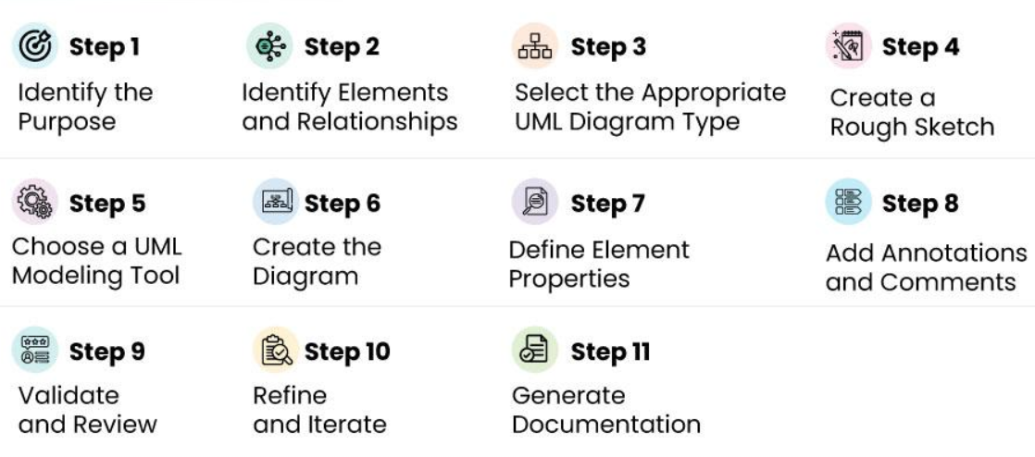
Steps to create UML Diagrams

